Slide 1


RESTAURANT MANAGEMENT SYSTEM
Database Project
Presented to:
Ma’am Asiya Batool

Slide 2

Presented BY:
Danish Abdullah Khan
Abubakar
Zunaira Akbar

Slide 3
CONTENTS
01
Introduction
02
Goals and Objectives
03
Tools Used
04
Learning
05
Relational Schema of Database
06
Graphical User Interface

Slide 4
Introduction
Developed the kamal_restaurant database as part of our database project
Aimed to streamline restaurant operations
Efficiently handles customer management
Manages order processing
Backbone of the food management system
Enhances customer experience
Demonstrates our proficiency in database design, development, and management
Addresses practical needs of modern restaurants

Slide 5
Goals and Objectives
Comprehensive Food Management System
Develop a scalable and secure database
Efficiently manage customer information, orders, menu items, payments, and ratings
User-Friendly Interface
Data Integrity and Security
Customer Feedback Mechanisms

Slide 6
Tools Used
Database Management: MySQL, Workbench
Programming Languages: Python
User Interface Development: Tkinter

Slide 7
Learning
Mastered MySQL for robust database creation and management
Designed sophisticated relational schemas using Workbench
Advanced Python skills for efficient backend development
Crafted intuitive user interfaces with Tkinter for seamless interaction
Integrated MySQL databases seamlessly into Python applications
Bridged backend functionalities with frontend UIs for cohesive systems
Implemented a comprehensive food management system addressing key restaurant operations

Slide 8
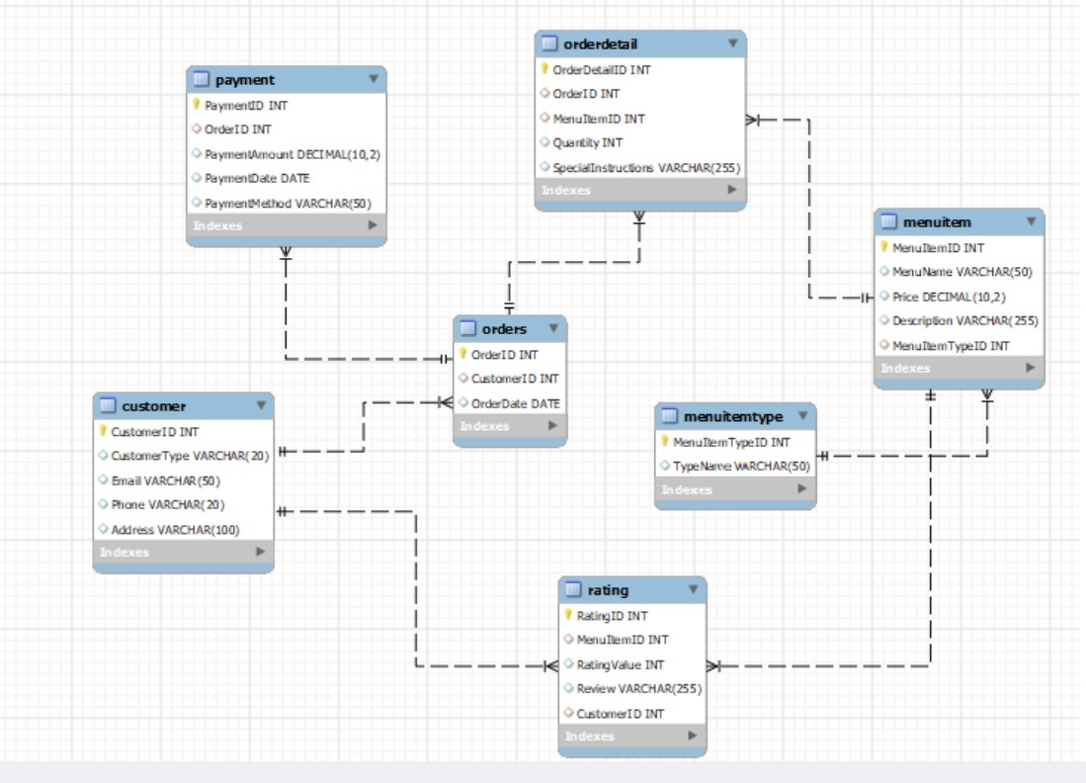
Relational Schema

Slide 9
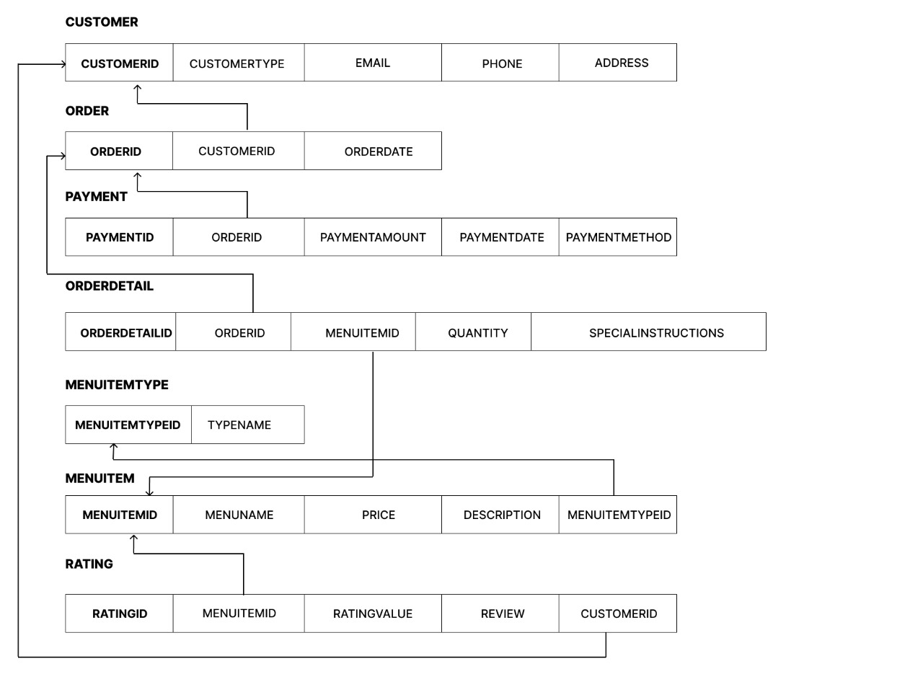

Slide 10
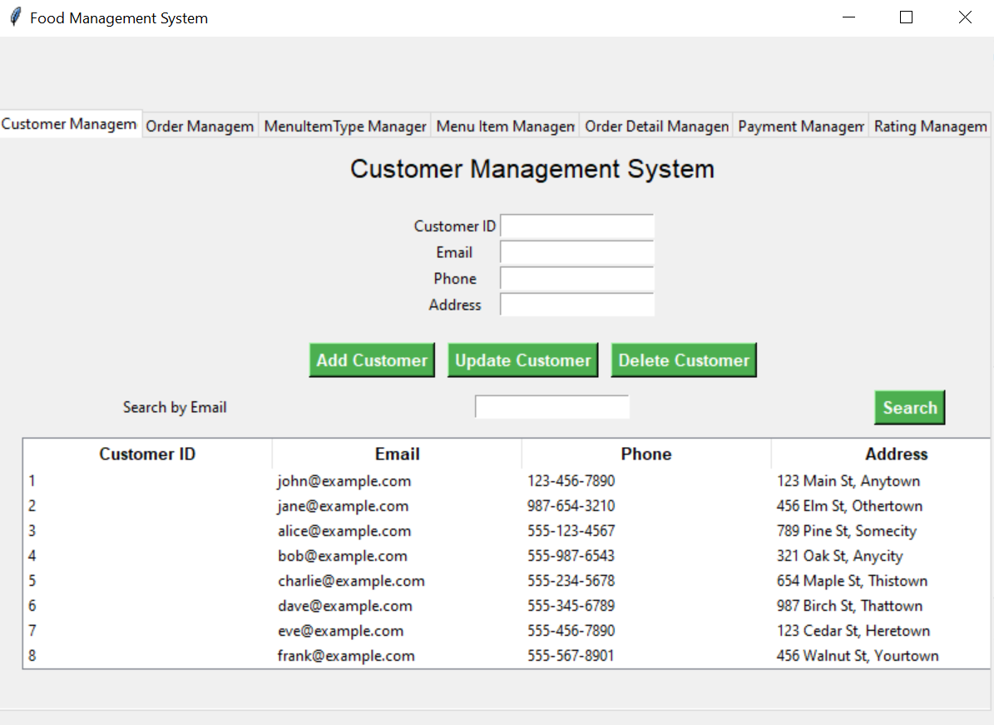
GUI

Slide 11
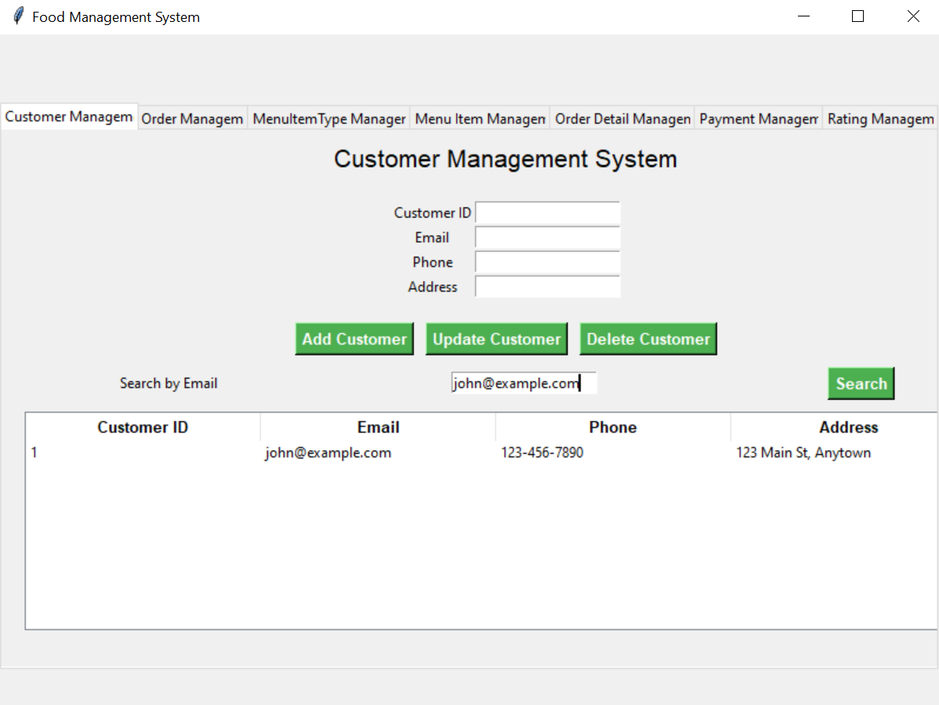
Searching by Email

Slide 12
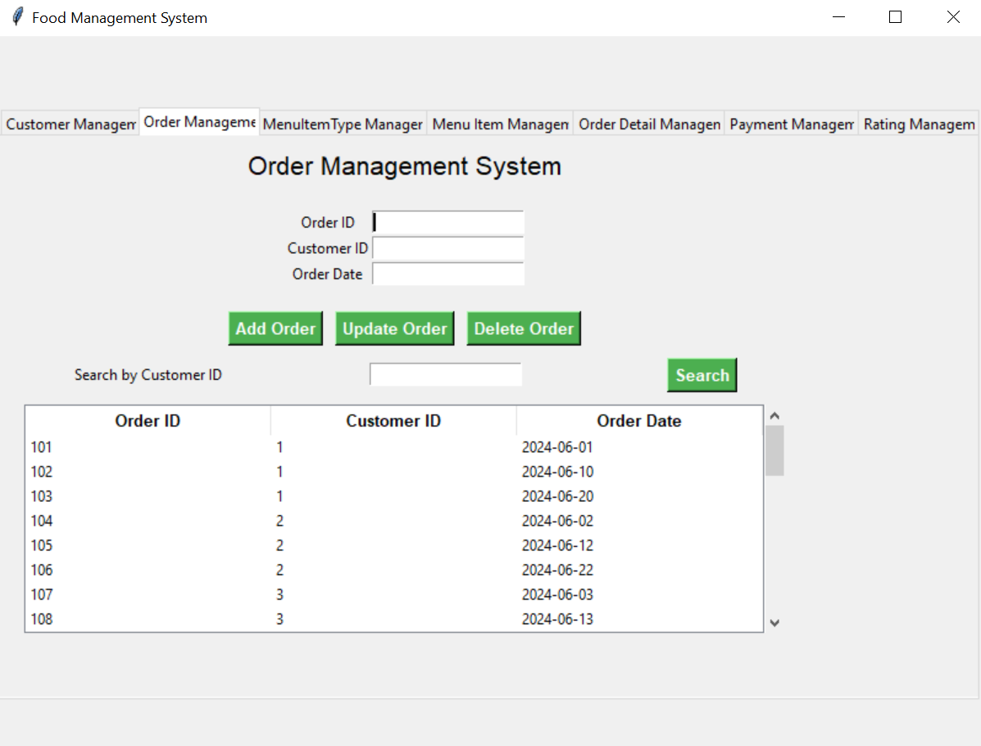

Slide 13
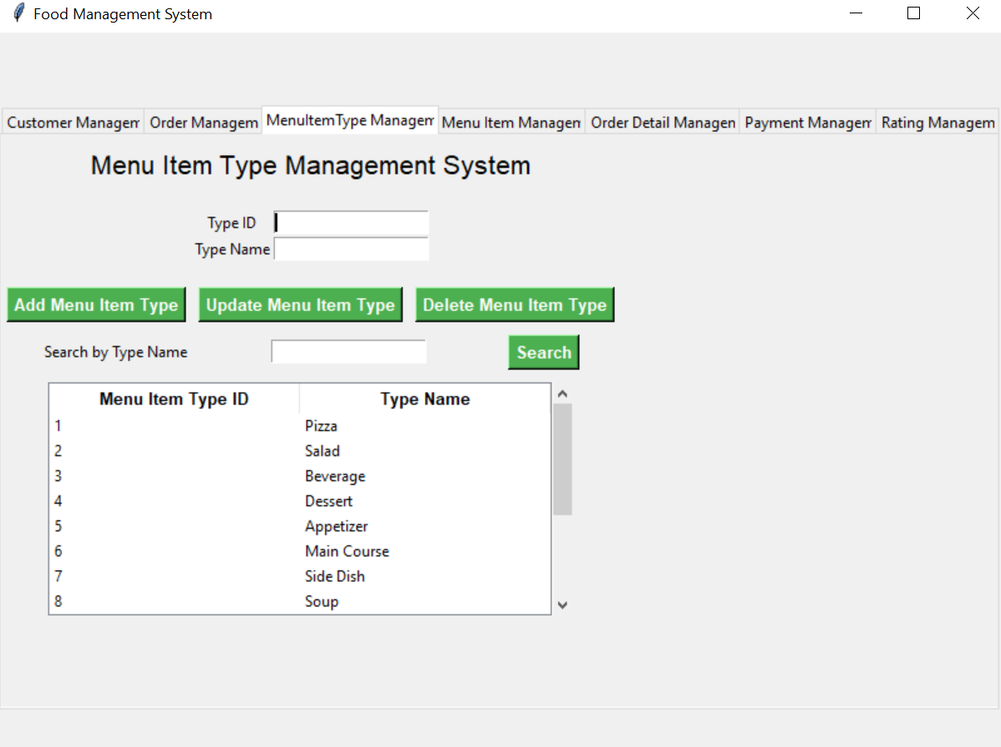

Slide 14
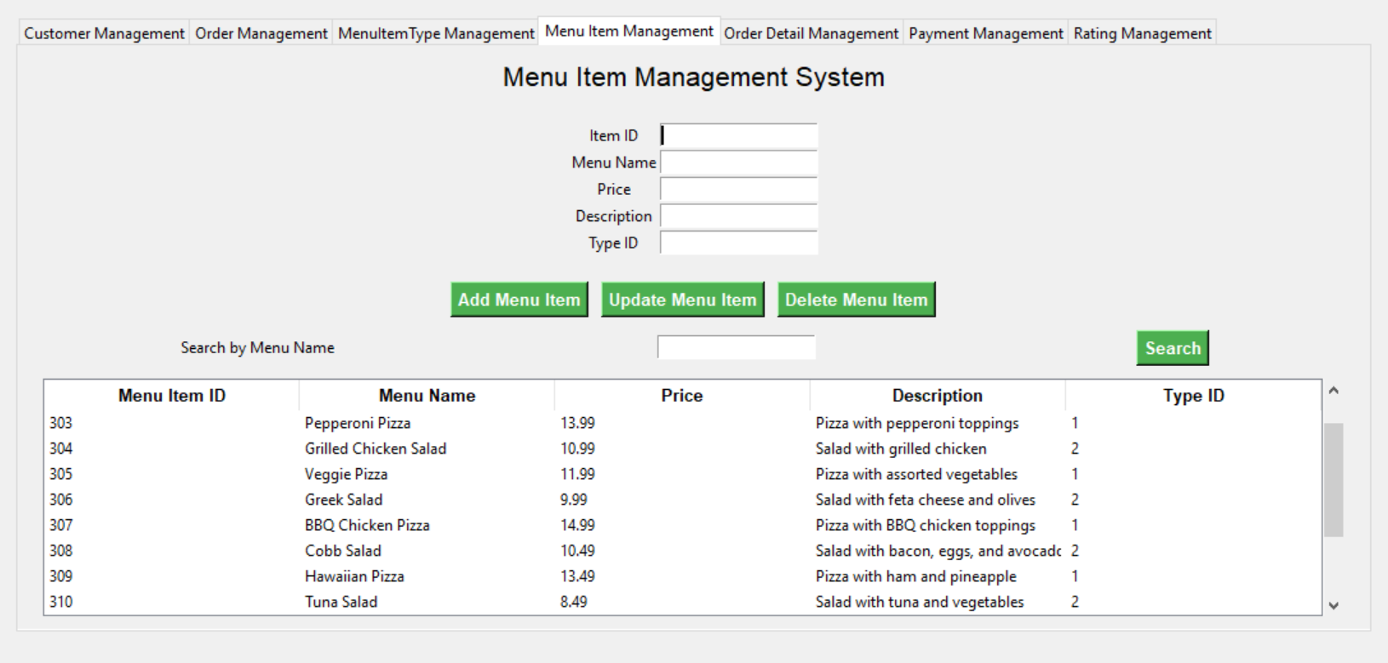

Slide 15
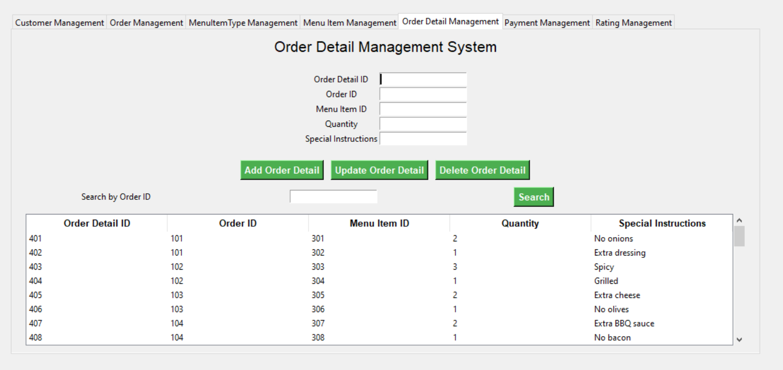

Slide 16
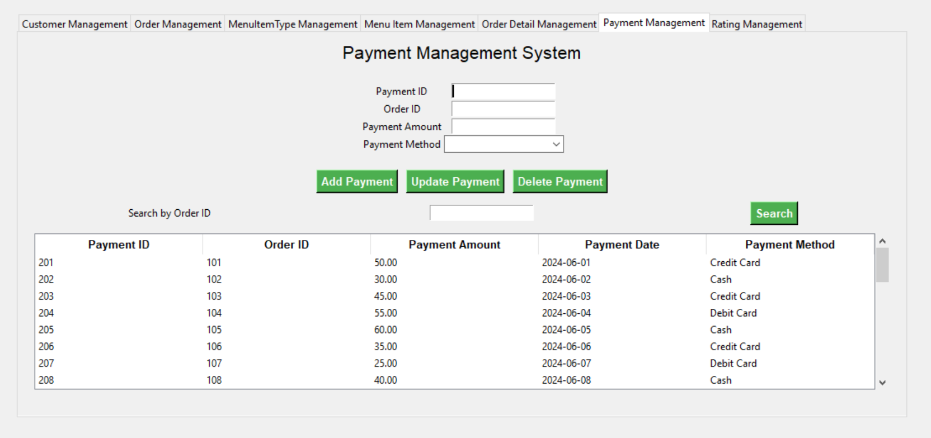

Slide 17
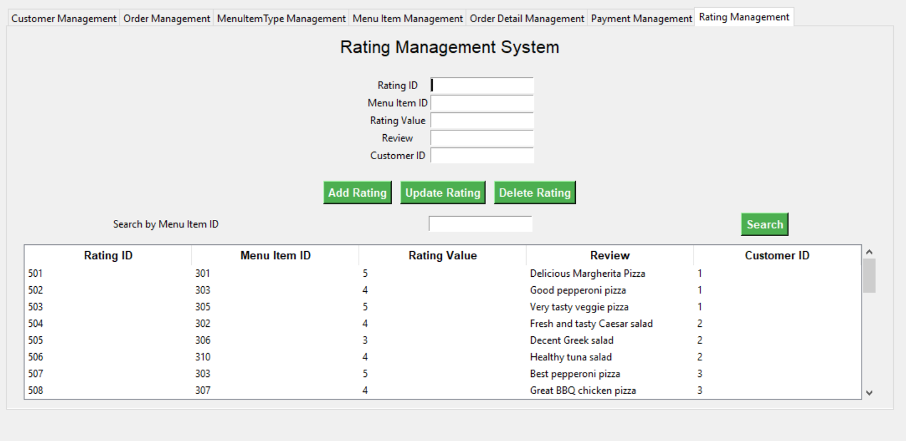

Slide 18

THANK
YOU.
CONTACT US IF YOU ARE
INTERESTED in our project.

